Slide 1
BW Training
Lesson 3: XML

Slide 2
Define XML Schema
To define a XML schema
  Add xml schema to project
  Edit root name of the schema
  Define the namespace of this schema
  Define the structure of the schema
  When added the node of the schema please select locally defined

Slide 3
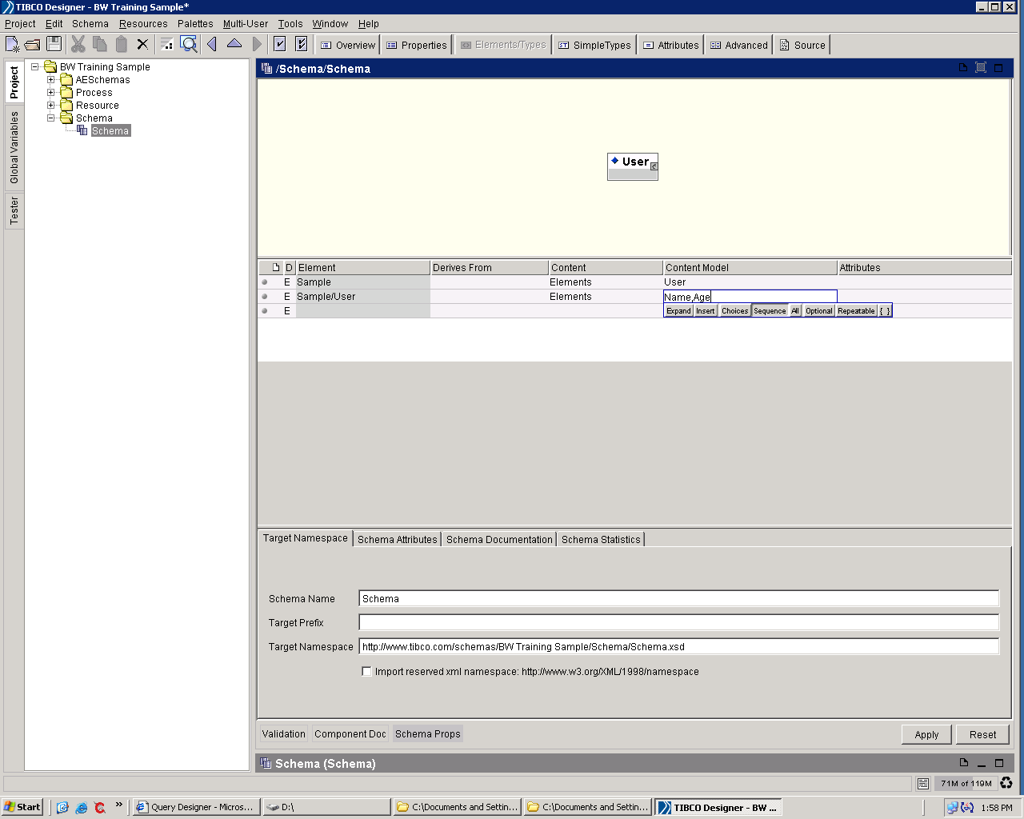
Define XML Schema

Slide 4
Define XML Schema
Content type of an element
  Elements - The content model contains elements only
  Typed - The content is either a simple type (such as string, integer or float) or a named complex type
  Empty - When an element has no content at all, its content model is empty. Essentially, a model is defined that allows only elements in its content but does not actually declare any elements, so the type's content model is empty.
  Any - The content model contains any combination of elements and/or character data (text)
  Mixed - In a mixed content model, an element contains other elements interleaved with character content. Character data can appear alongside child elements and is not confined to the deepest child elements.

Slide 5
Define XML Schema
Import common schema
  You can define a common XML schema in your project so that you do not need to define the same structure again and again
  Click the overview mode
  Import the common schema
  Insert the node you want to the current schema

Slide 6
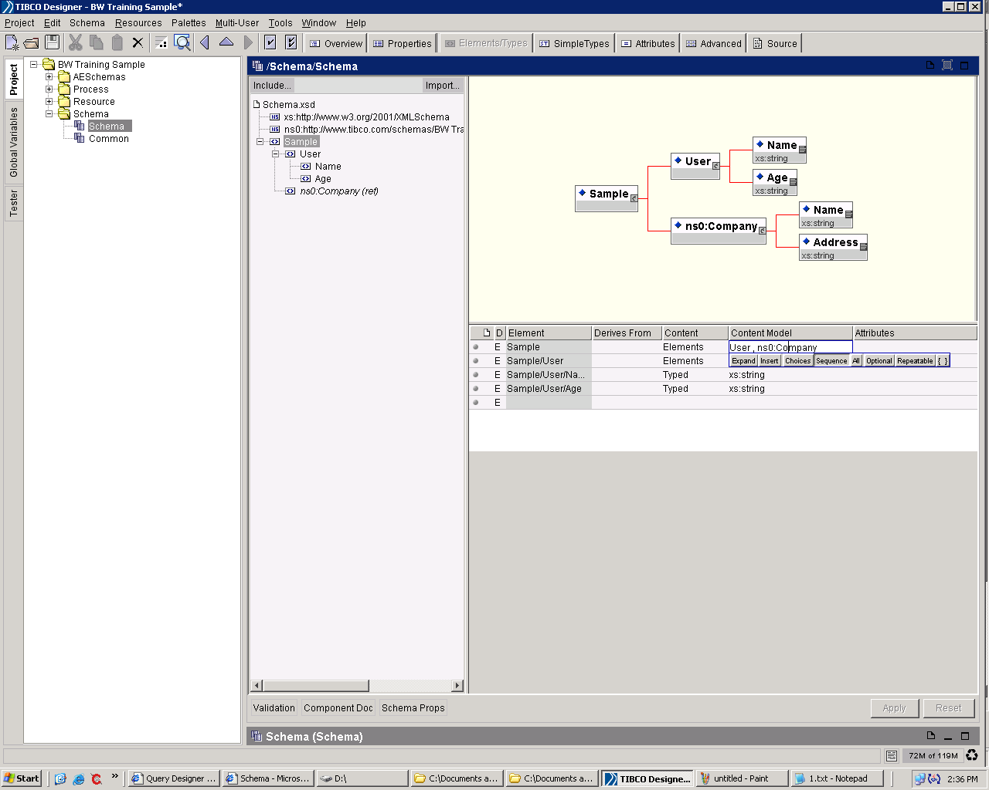
Define XML Schema

Slide 7
Use XML
Parse XML
  The Parse XML activity takes a binary XML file or an XML string and processes it, turning it into an XML schema tree based on the XSD or DTD specified.
  Click output editor tab and add a xml schema as out put

Slide 8
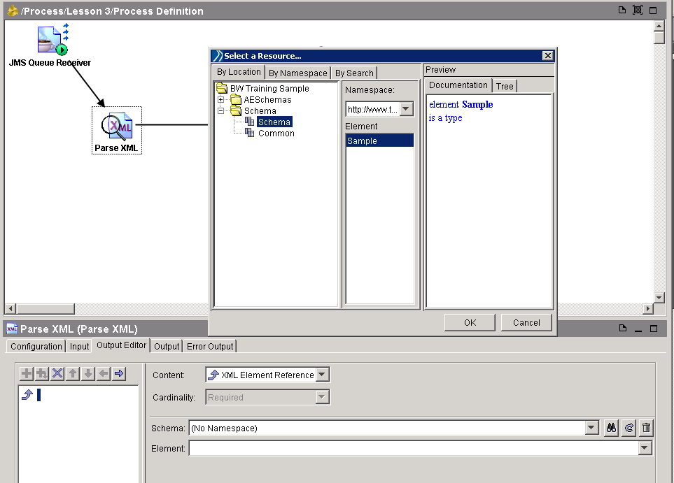
Use XML

Slide 9
Use XML
Render XML
  The Render XML activity takes an instance of an XML schema element and renders it as a stream of bytes containing XML or an XML string. The schema is processed based on the XSD file specified.
  Click input editor tab and add a xml schema as out put

Slide 10
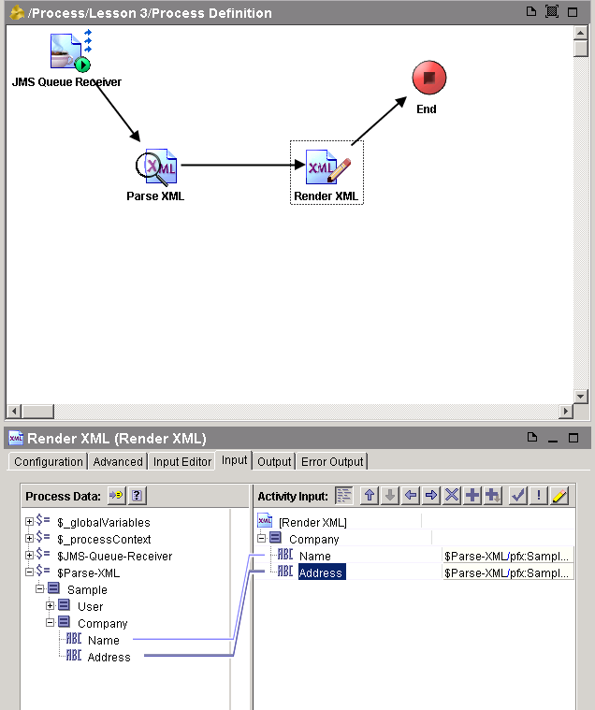
Use XML
Transfer Data
  Now we can link the data from parse xml activity to render xml activity
  That means transfer the data from one activity to another activity.

